Slide 1
UNEXPECTED TUSCANY
Tenuta del Buonamico
WINE & LUXURY HOSPITALITY

Slide 2
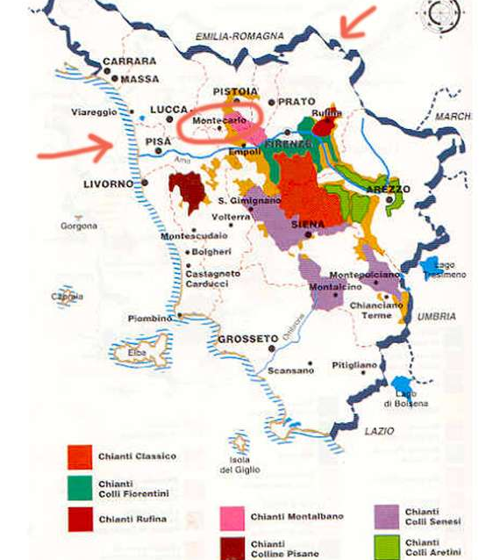
Where we are
in Tuscany
10 miles from Lucca
20 miles from Versilia (Forte dei Marmi)
at 150 mt above sea level
in the medieval village of Montecarlo
half way between Florence and Pisa
TENUTA DEL BUONAMICO

Slide 3
Wine Production area
since 846 AD.
Montecarlo
Tuscany's northernmost DOC
Among the smallest Italian Docs - 200 ha
whose microclimate is influenced by:
nearness to Apuane Alps
airstreams from seaside
hillside
great excursions between day & night
Montecarlo Doc is home to native grape varieties
like Sangiovese and international grape varieties.
The latter since 1870.
TENUTA DEL BUONAMICO

Slide 4
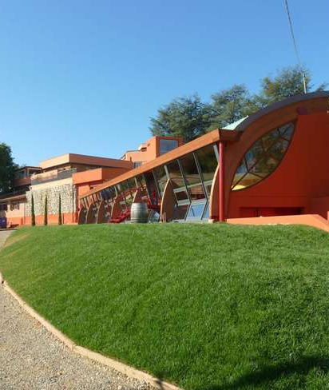
Our Estate
Main Facts
A Family business running from 1964
Fontana family manages 100 hectares of land, of whom 48 are under vine (traditional & international grape varieties)
Sustainable sparkling and still wines production
First and only Tuscan sparkling producer with on-site vinification and production
Leading producer of Montecarlo Doc, one of the smallest DOC in Italy (200 ha) famous for its international grape blends, planted in 1870
Oldest Syrah vineyard in Tuscany
Exclusive Wine Resort and Gourmet Restaurant on-site
TENUTA DEL BUONAMICO

Slide 5
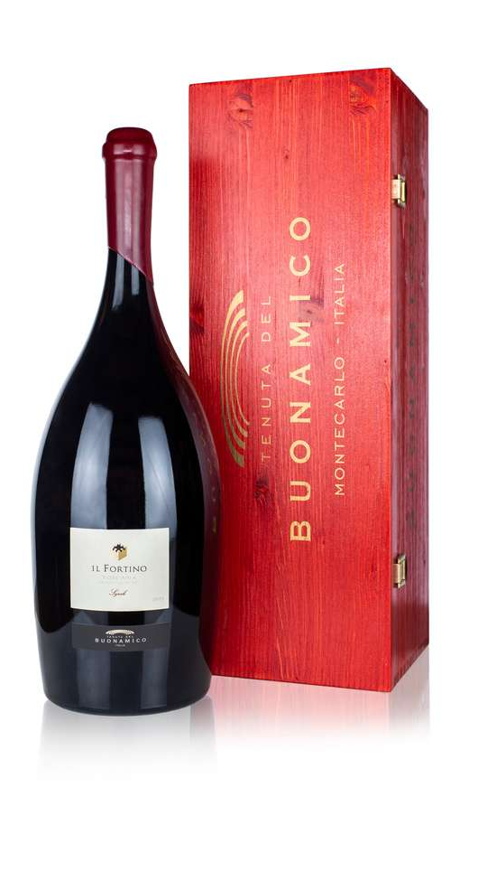
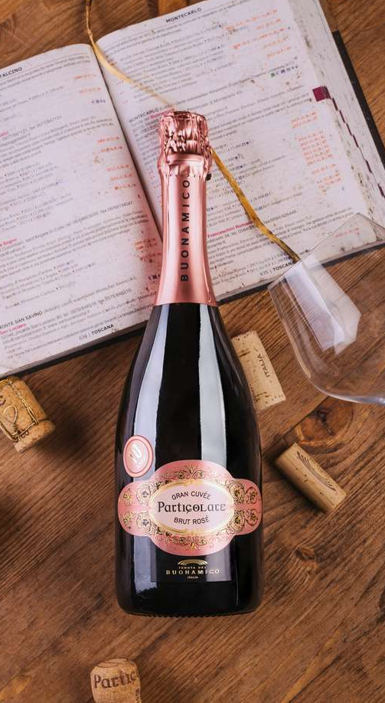
Our Wines
Sparkling Charmat Method
White Montecarlo Doc
Red Montecarlo Doc
Igt Toscana made with traditional
grapes like Sangiovese and
international ones like Pinot Blanc,
Viognier, Cabernet Sauvignon,
Syrah and Merlot
TENUTA DEL BUONAMICO

Slide 6
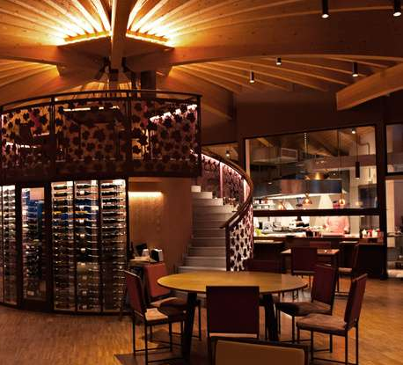
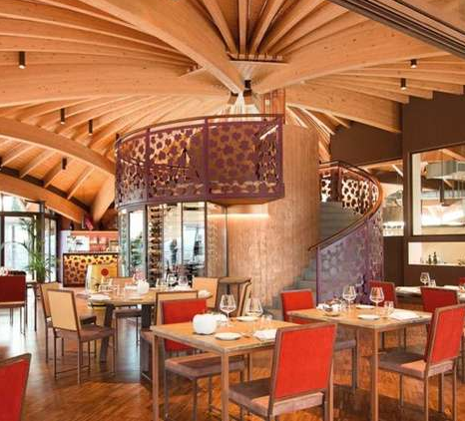
Our Hospitality
Wine Resort with 11 Deluxe Rooms
Gourmet Restaurant
Wellness Centre
Outdoor swimmingpool overlooking
the vineyards
Wine tours & vineyards walking
Free outdoor parking
Repower electric charge service
TENUTA DEL BUONAMICO
TENUTA DEL BUONAMICO

Slide 7
Our Awards
Spumante Particolare Brut Rosé 91/100
Cercatoja IGT Toscana 94/100
Il Fortino IGT Toscana 94/100
Cercatoja IGT Toscana 93/100
Dea Rosa IGT Toscana 91/100
Mio Viognier IGT Toscana 91/100
Montecarlo Bianco Doo 91/100
Vivi Vermentino IGT Toscana 90/100
Cercatoja IGT Toscana Gold Medal
Best Rosé Sparkling - Charmat Method
TENUTA DEL BUONAMICO

Slide 8
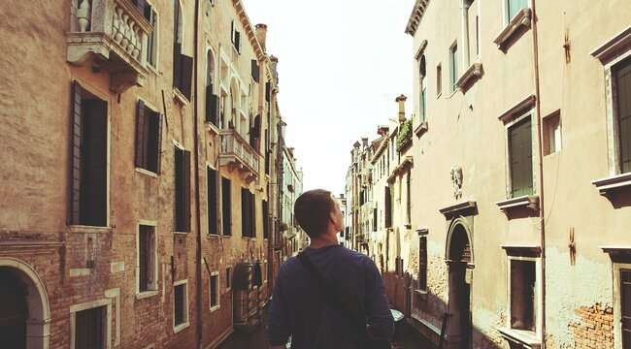
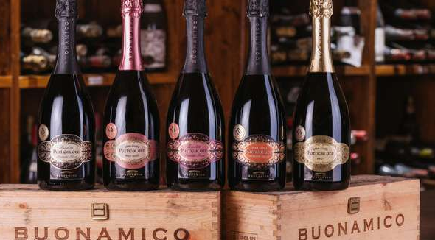
THANKS FOR YOUR ATTENTION
www.buonamico.it
eugeniofontana@buonamico.com

